Slide 1
Introduction to Mongo DB (NO SQL data Base)
PANKAJ KAPOOR
(Your trainer)

Slide 2
Overview
What is NO SQL Data base?
What is Mongo DB?
What is database, collection and documents
Why Mongo DB?
Advantages of MongoDB over RDBMS
Where to Use MongoDB?
Mongo DB Architecture.
Document (JSON) Structure.
Different Methods.
When to use Mongo DB?

Slide 3
What is No SQl data base
It’s Not No SQL it’s NOT ONLY SQL.
It’s not even a replacement to RDBMS.
As compared to the good olden days we are saving more and more data.

Slide 4
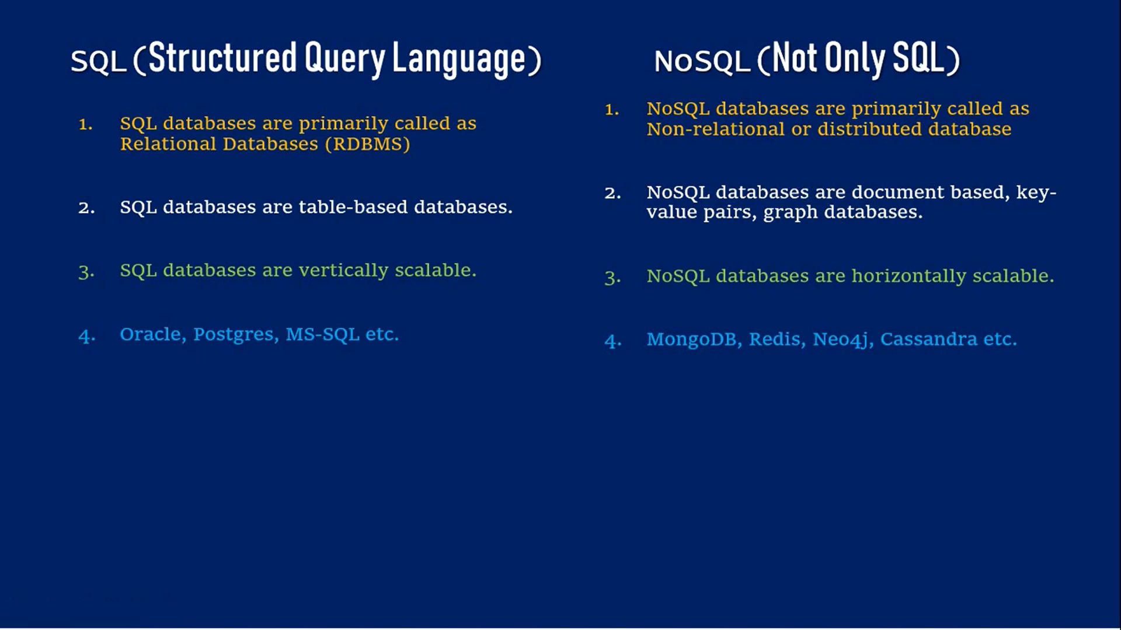
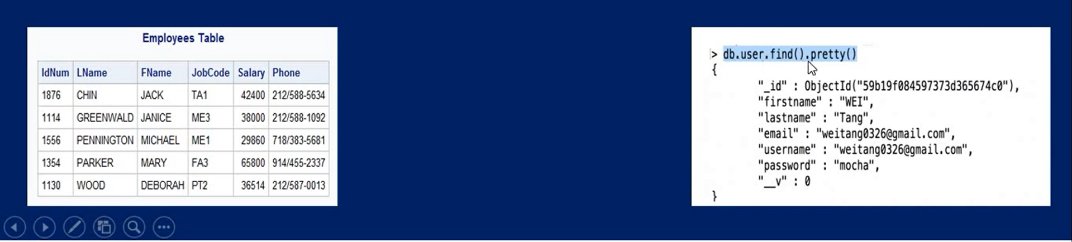
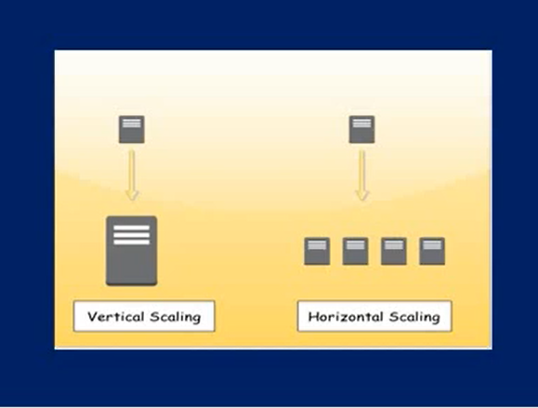

Slide 5
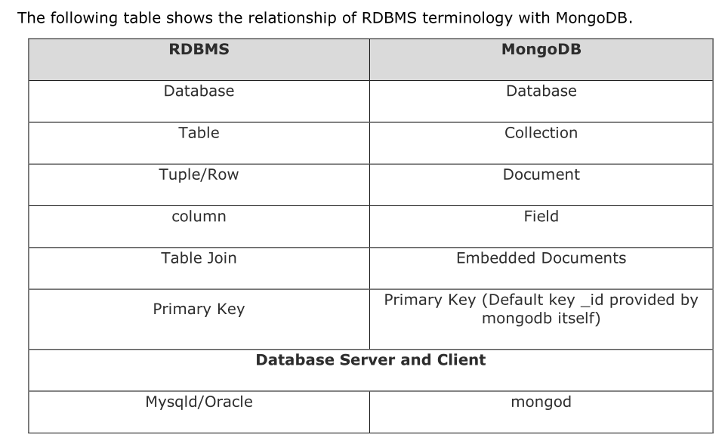

Slide 6
What is Mongo DB
MongoDB is a cross-platform, document oriented database that provides
High performance.
High availability.
Easy scalability.
MongoDB works on concept of collection and document.

Slide 7
Database – Collection - Document
Database
Database is a physical container for collections. Each database gets its own set of files on the file system. A single MongoDB server typically has multiple databases.
Collection
Collection is a group of MongoDB documents. It is the equivalent of an RDBMS table. A collection exists within a single database. Collections do not enforce a schema. Documents within a collection can have different fields. Typically, all documents in a collection are of similar or related purpose.
Document
A document is a set of key-value pairs. Documents have dynamic schema. Dynamic schema means that documents in the same collection do not need to have the same set of fields or structure, and common fields in a collection's documents may hold different types of data.

Slide 8
Mongo DB architecture
Architecture : -
Database
Document
Container

Slide 9
Advantages of MongoDB over RDBMS
Schema less: MongoDB is a document database in which one collection holds different documents. Number of fields, content and size of the document can differ from one document to another.
Structure of a single object is clear.
No complex joins.
Deep query-ability. MongoDB supports dynamic queries on documents using a document-based query language that's nearly as powerful as SQL.
Tuning.
Ease of scale-out: MongoDB is easy to scale.
Conversion/mapping of application objects to database objects not needed.
Uses internal memory for storing the (windowed) working set, enabling faster access of data.

Slide 10
Why Use MongoDB?
Document Oriented Storage: Data is stored in the form of JSON style documents.
Index on any attribute
Replication and high availability
Auto-sharding
Rich queries
Fast in-place updates
Professional support by MongoDB

Slide 11
Where to Use MongoDB?
Big Data
Content Management and Delivery
Mobile and Social Infrastructure
User Data Management
Data Hub

Slide 12
Types of No SQl data base
Key Value pair
Dynamo DB
Azure Table Storage (ATS )
Graph database
Document Based
Mango Db
AmazonSimple DB
Couch DB
Column Oriented database
(#key,#value)
(Name, Tom)
(Age,25)
(Role, Student)
(University, CU)
[
{
"Name": "Tom",
"Age": 30,
"Role": "Student",
"University": "CU",
}
]
Masters
Row Id | Columns
1 | Name | Tom
 | Age | 25
 | Role | Student
Tom
Student
Courses
Bigtable(Google)
Name
Age
CU
Neo4j
Infogrid
HBase
25
Ottawa
Location

Slide 13
Why Mongo DB?
All the modern applications deals with huge data.
Development with ease is possible with mongo DB.
Flexibility in deployment.
Rich Queries.
Older database systems may not be compatible with the design.
And it’s a document oriented storage:- Data is stored in the form of JSON Style.

Slide 14
Document(JSON) structure
[
{
"Name": "Tom",
"Age": 30,
"Role": "Student",
"University": "CU",
}
{
"Name": “Sam",
"Role": "Student",
"University": “OU",
“Subject": “Compiler",
}
]
The document has simple structure and very easy to understand the content
JSON is smaller, faster and lightweight compared to XML.
For data delivery between servers and browsers, JSON is a better choice
Easy in parsing, processing, validating in all languages
JSON can be mapped more easily into object oriented system.

Slide 15
The insert() Method
Example: -
db.StudentRecord.insert (
{
"Name": "Tom",
"Age": 30,
"Role": "Student",
"University": "CU",
},
{
"Name": “Sam",
"Age": 22,
"Role": "Student",
"University": “OU",
}
)
To insert data into MongoDB collection, you need to use MongoDB's insert() or save() method.
The basic syntax of insert() command is as follows −
“db.COLLECTION_NAME.insert(document)”

Slide 16
The find() Method
Example: -
To query data from MongoDB collection, you need to use MongoDB's find() method.
The basic syntax of find() method is as follows −
“db.COLLECTION_NAME.find()”
find() method will display all the documents in a non-structured way.
To display the results in a formatted way, you can use pretty() method.
“db.mycol.find().pretty() “
db.StudentRecord.find().pretty()

Slide 17
The remove() Method
Remove based on DELETION_CRITERIA
db.StudentRecord.remove({"Name": "Tom})
Remove Only One:-Removes first record
db.StudentRecord.remove(DELETION_CRITERIA,1)
Remove all Records
db.StudentRecord.remove()
MongoDB's remove() method is used to remove a document from the collection. remove() method accepts two parameters. One is deletion criteria and second is justOne flag.
deletion criteria − (Optional) deletion criteria according to documents will be removed.
justOne − (Optional) if set to true or 1, then remove only one document.
Syntax
db.COLLECTION_NAME.remove(DELLETION_CRITTERIA)

Slide 18
When to use Mongo Db?
When your requirements has these properties :
You absolutely must store unstructured data. Say things coming from 3rd-party API you don’t control, logs whose format may change any minute, user-entered metadata, but you want indexes on a subset of it.
You need to handle more reads/writes than single server can deal with and master-slave architecture won’t work for you.
You change your schema very often on a large dataset.

Slide 19


